Slide 1

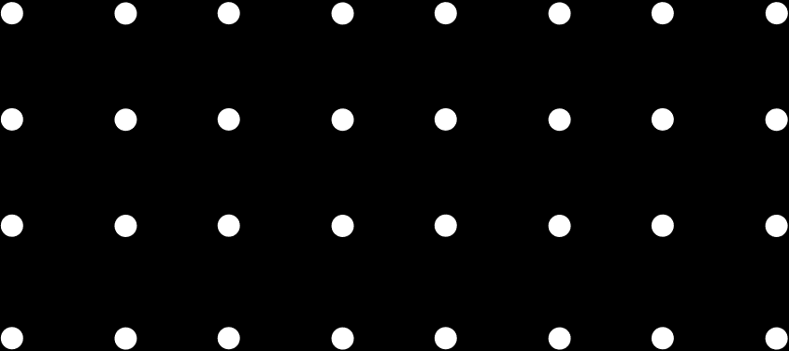
THE ANIME
RECOMMENDATION SYSTEM
BUILT BY ANGELA ROXANA

Slide 2

Table of Contents
01
Introduction
05
Feature Engineering
02
Data Collection
06
Model Training
03
Data Preprocessing
07
Conclusion
04
Exploratory data analysis (EDA)

Slide 3

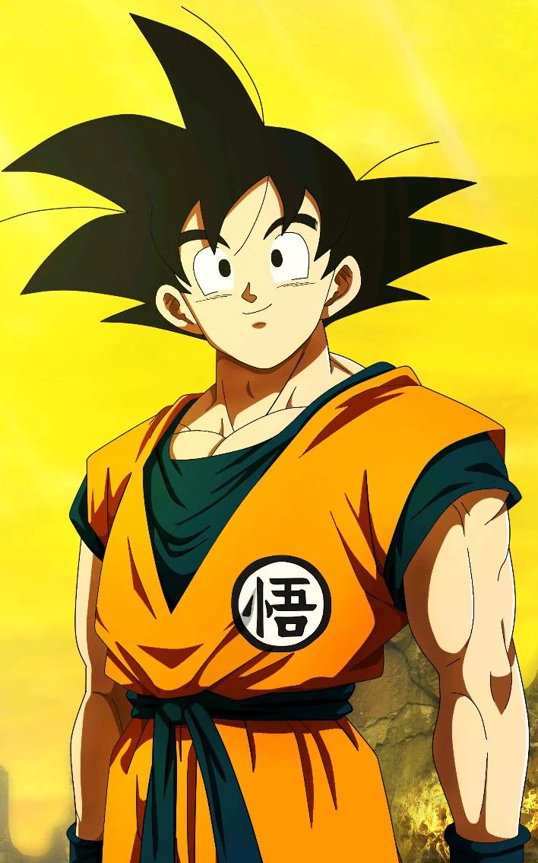
03
Introduction
Anime Recommendation System is a machine-learning model that generates a list of personalized anime recommendations based on the watch history of the user.
The model is trained with over +12,000 anime and over 7.8 Million user reviews. This model is set to identify similar patterns to suggest an anime likely to be in the user's interest.

Slide 4
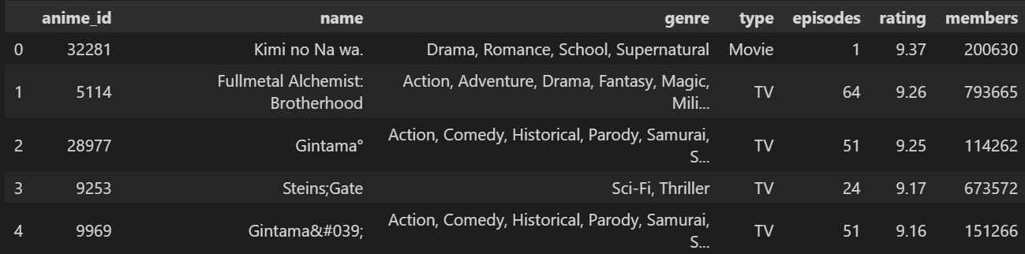
04
Data Collection

Slide 5
Data Preprocessing
1
Decoding HTML Characters
2
Filtering Null/Unknown Values
3
Checking Multi-Collinearity
05

Slide 6
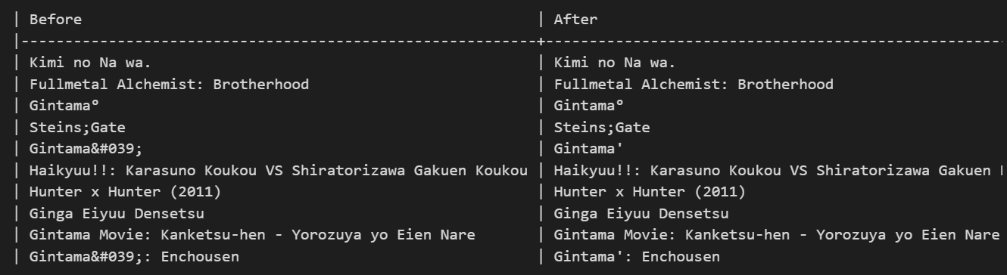
06
Decoding HTML Characters

Slide 7
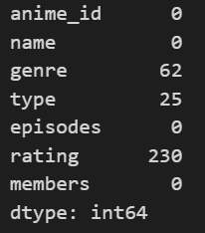
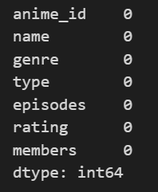
07
Filtering Null/Unknown Values

Slide 8
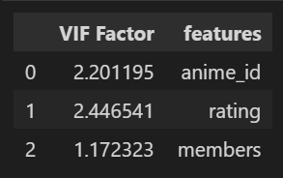
08
Checking Multi-Collinearity

Slide 9
EDA (Exploratory Data Analysis)
1
Removing Punctuations
2
Word Count
3
Word Cloud
09

Slide 10
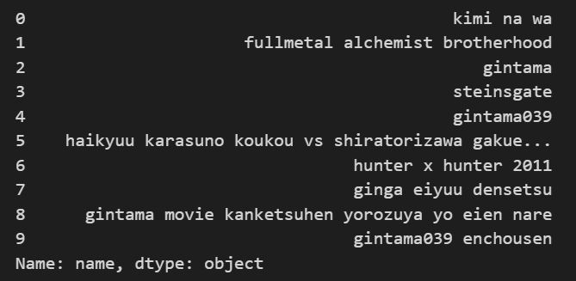
10
Removing Punctuations

Slide 11
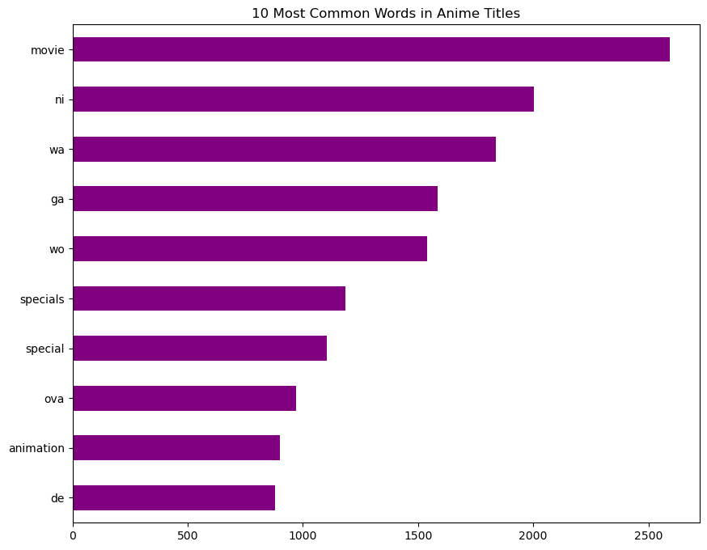
11
Word Count
The word count helps in showing which word is occurring how many times, and based on this result, the term "movie", which is a type of show, has been occurring more than 2,500 times.
With TF-IDF, we can remove external references like movies to make the search result more accurate.

Slide 12
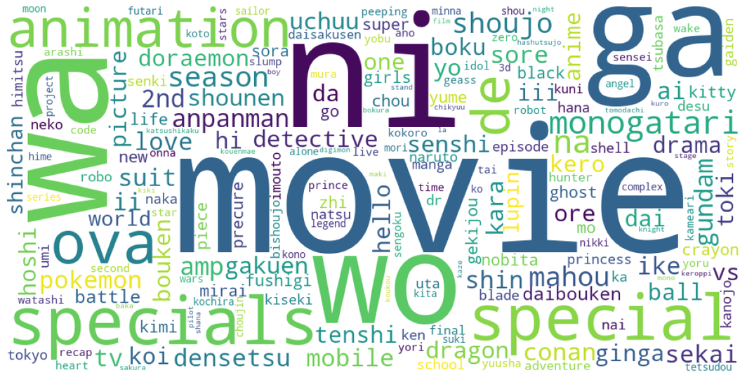
12
World Cloud

Slide 13
Feature Engineering
1
TF-IDF Vectorizer
2
TF-IDF Based Word Cloud
3
Cosine Similarity
13

Slide 14
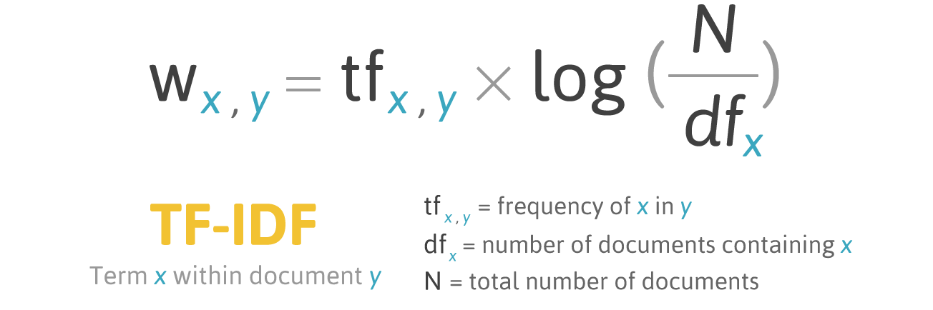
14
TF-IDF Vectorizer
TF-IDF is a measure of how important a word is in a document by taking account of the word's frequency (count), relative to all the documents in a collection.

Slide 15
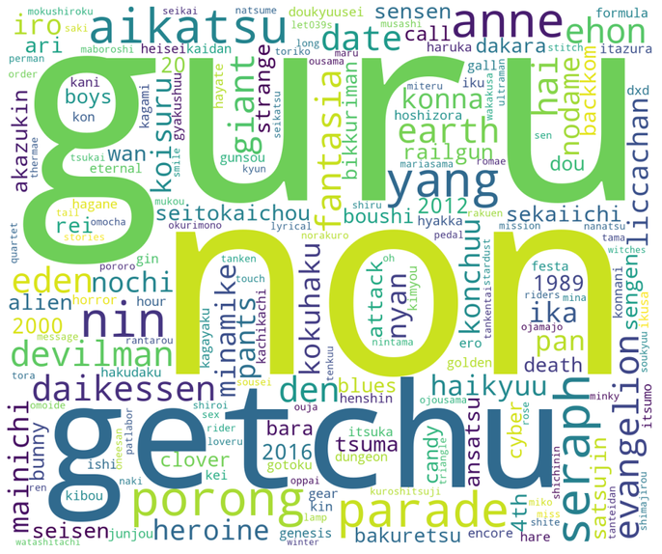
15
TF-IDF World Cloud

Slide 16
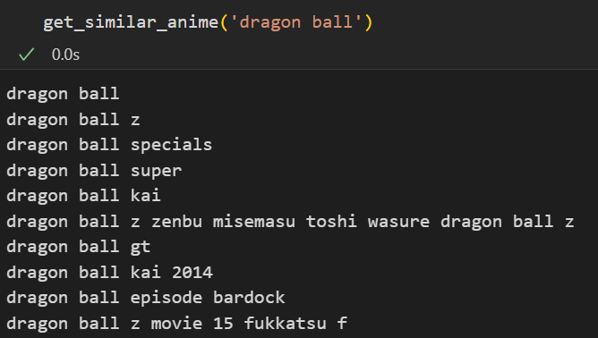
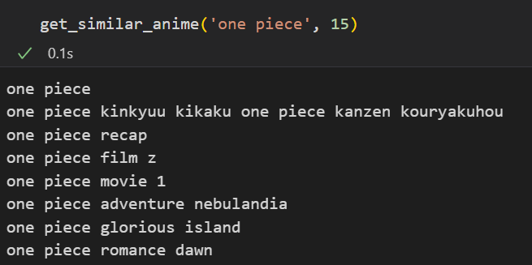
16
Cosine Similarity

Slide 17
Model Training
1
K-Nearest Neighbors (KNN)
4
Why No Accuracy?
2
Decision Tree
3
Support Vector Machine (SVM)
17

Slide 18
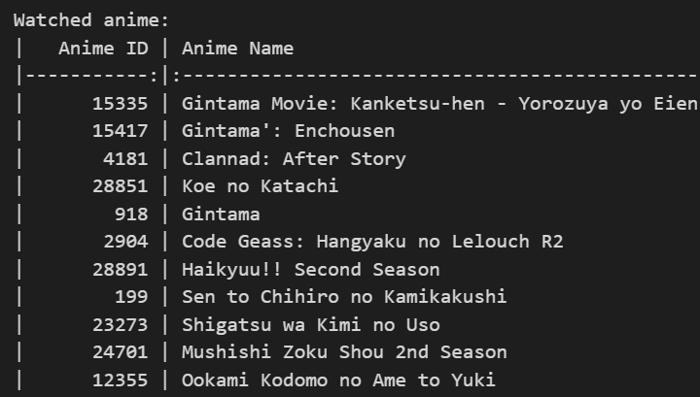
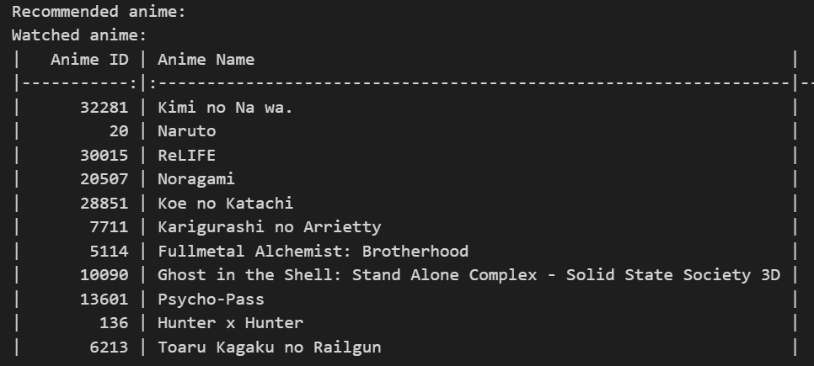
18
K-Nearest Neighbors (KNN)
.

Slide 19
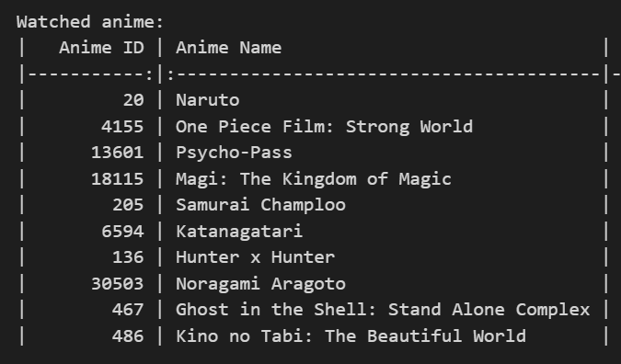
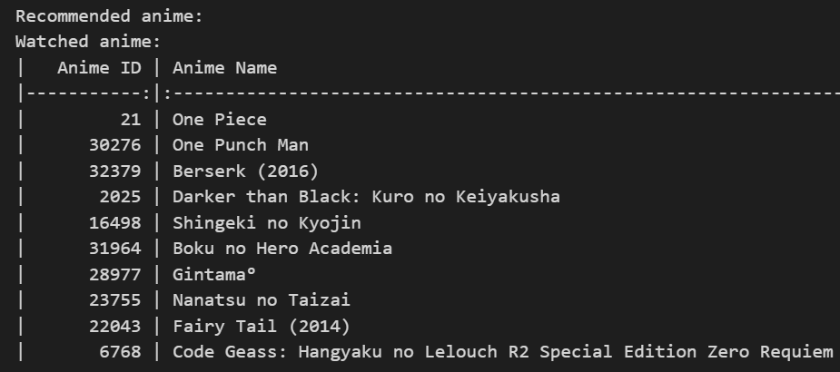
19
Decision Tree

Slide 20
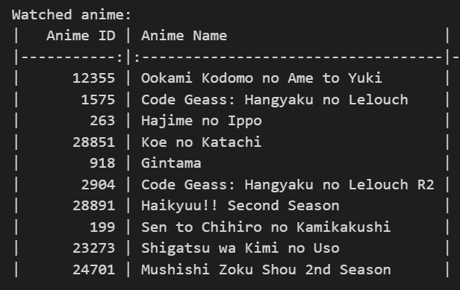
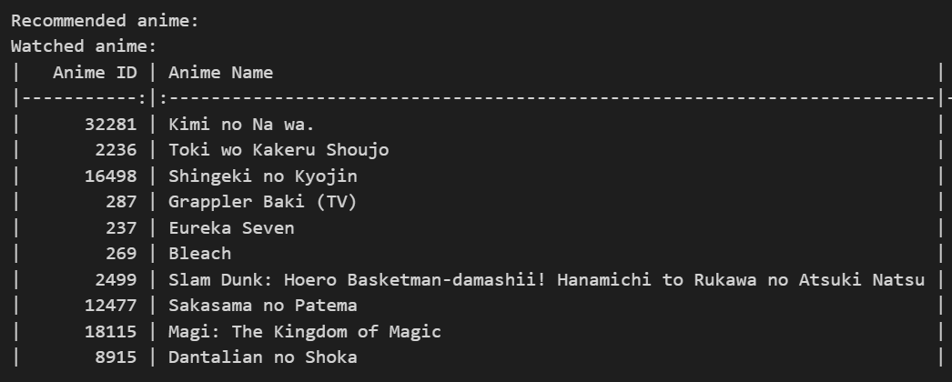
20
Support Vector Machine (SVM)

Slide 21
21
Why No Accuracy?
This model is not built with the mind of user preference as every user, even the person finding the anime, has their own preference and tastes. A good example of this is similar to a cake and an apple.
People who like sweets more would go for cake, while people who don't like sweets or avoid sweets, would go for apples, or may not go for either. There's a preference of a person and a system cannot be aware of it unless the model is explicitly trained for each user (which is tons of data to deal with).

Slide 22

Conclusion
With this, we came to the conclusion of the anime recommendation project.
We looked at some constructive ways to preprocess the data, performed EDA, worked with feature engineering, and finally trained the data using KNN, Decision Tree, and SVM machine learning models to give anime recommendations to the user.
Hope everyone liked this project!
22

Slide 23

THANK YOU!
BUILT BY ANGELA ROXANA

